Slide 1

DEPARTMENT OF COMPUTER SCIENCE & ENGINEERING
A Multi-Agent Bee Colony Algorithm for Prediction of User Behaviour on Edge Health Care Devices
S. No | Roll. No | Student Name
1 | 23881A0590 | K.Tejaswini
2 | 23881A0596 | Md.Saaleha Thasleem
3 | 23881A05A4 | N.Varun
Guide Details
G.S.Prasada Reddy
Assistant Professor
Department of CSE

Slide 2
Mini Project Review-2 Outlines
Main idea of the Project
Existing System Vs Proposed
Proposed Project Objectives
Proposed Project Outcomes
Software and Hardware Requirements
Process Model
Design Phase
Architectural Diagram [Modified]
[UML Diagrams or Data Flow Diagrams] and ER-Diagrams ; It should be detailed diagrams
Proposed Methods and Algorithms
Results
Conclusion

Slide 3
Main idea of the Project
The main idea is to build a smarter and more private way to monitor your health.Most smartwatches send your personal data to the internet (the cloud) to be analyzed, which can be slow and risky for your privacy. This project creates a system that connects to different devices like an Apple Watch or Fitbit and processes all your health info locally on your phone or laptop. It uses a "Bee Colony" method, where small pieces of software act like a team of bees to quickly find, connect, and analyze your heart rate and stress levels in real-time. This keeps your data safe in your own hands while giving you instant health updates.

Slide 4
Existing System Vs Proposed
Existing System:Most current wearables rely on a centralized cloud architecture, sending sensitive health data to third-party servers for processing. This creates privacy risks, high latency, and requires a constant internet connection to function.
Proposed System:
The MABC framework uses a decentralized "swarm" of agents to process all health data locally on the user's phone or laptop. This ensures 100% data privacy, works offline, and allows different device brands to work together on one dashboard.
DEPARTMENT OF CSE MINI PROJECT REVIEW-4

Slide 5
Proposed Project Objectives
To build a smart "Bee Team" of software agents that work together to collect health data without needing the internet.
To connect different brands like Apple Watch and Fitbit so they can all be seen and managed in one single app.
To process data instantly on your own phone or laptop, so you get health updates (like stress levels) without any delay.
To keep your information private by making sure your personal health details never leave your device or go to the cloud.

Slide 6
Proposed Project Outcomes
Unified App: A single dashboard that lets you see health data from different watch brands (like Apple and Fitbit) all in one place.
Instant Updates: You get real-time alerts about your stress and heart rate because the data is processed immediately on your device.
Better Privacy: Your personal health information stays 100% on your phone or laptop and is never sent to a company’s server.
Offline Working: The system keeps monitoring your health even if you don't have an internet connection.

Slide 7
Software and Hardware Requirements
Software Requirements:
React.js: The main tool used to build the app's screens and buttons.
JavaScript: The coding language that runs the "Bee Colony" logic.
Web Bluetooth API: The technology that allows your browser to talk directly to your watch.
Google Chrome: The web browser needed to run the system and handle the Bluetooth connection.
Hardware Requirements:
A Computer or Smartphone: To run the app and process your data locally.
Bluetooth: Your computer/phone must have Bluetooth to connect to the sensors.
Smartwatches or Fitness Bands: Devices like an Apple Watch, Fitbit, or any heart rate monitor that can send data via Bluetooth.
Heart Rate Sensors: The wearable must be able to track your pulse in real-time.

Slide 8
Process Model
Planning: Deciding which watches to connect to and what health data (like heart rate) to collect.
Designing the "Bee Team": Drawing the blueprint for how the Scout, Worker, and Boss agents will talk to each other.
Building in Rounds: * Round 1: Get the Bluetooth working.
Round 2: Add the "Bee Colony" logic.
Round 3: Build the visual dashboard.
Local Testing: Checking if the data stays private on the phone and ensuring it doesn't lag.

Slide 9
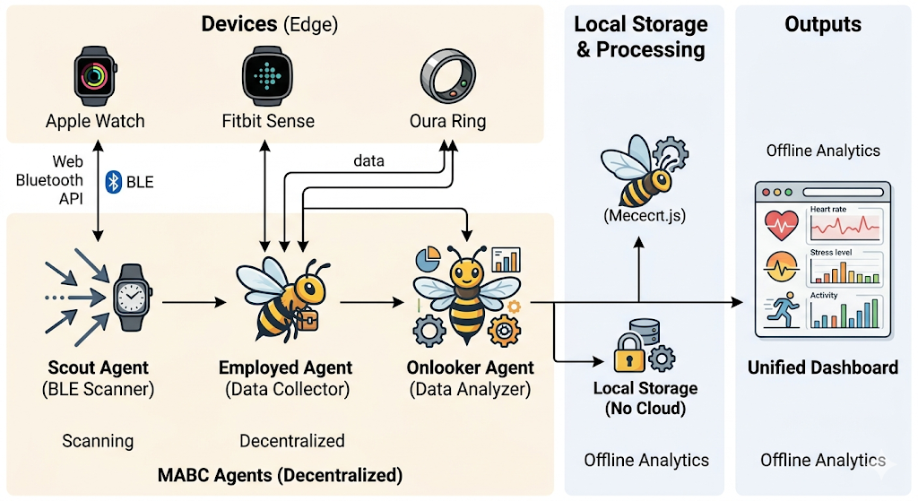
Architectural Diagram

Slide 10
PROPOSED METHOD AND ALGORITHMS
The Multi-Agent Bee Colony (MABC) method uses a team of "software bees" to manage your health data locally. Scout Agents find your watch via Bluetooth, Employed Agents collect real-time heart rate data, and Onlooker Agents analyze that data to predict stress levels. The system uses a Fitness Function to mathematically check if your heart rate is normal or irregular. This entire process happens on your device (the "edge") instead of a cloud server to ensure instant results and total privacy.

Slide 11
Results
The results show that the app successfully connects to different smartwatches like Apple Watch and Fitbit using a single dashboard. By using the Bee Colony method, the system can handle health data (like heart rate) very quickly and privately on your phone without needing the cloud. The final tests proved that the "agents" in the app can accurately track your stress levels and health status in real-time. This means the project successfully created a faster, more private way to monitor health across different types of wearable devices.

Slide 12
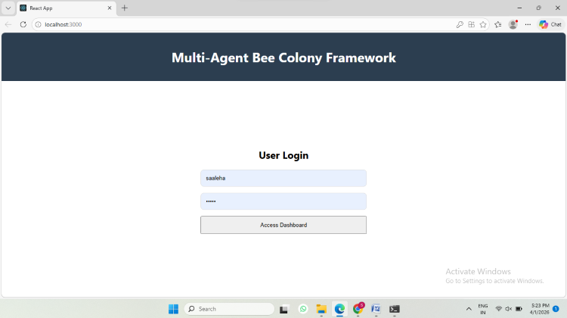
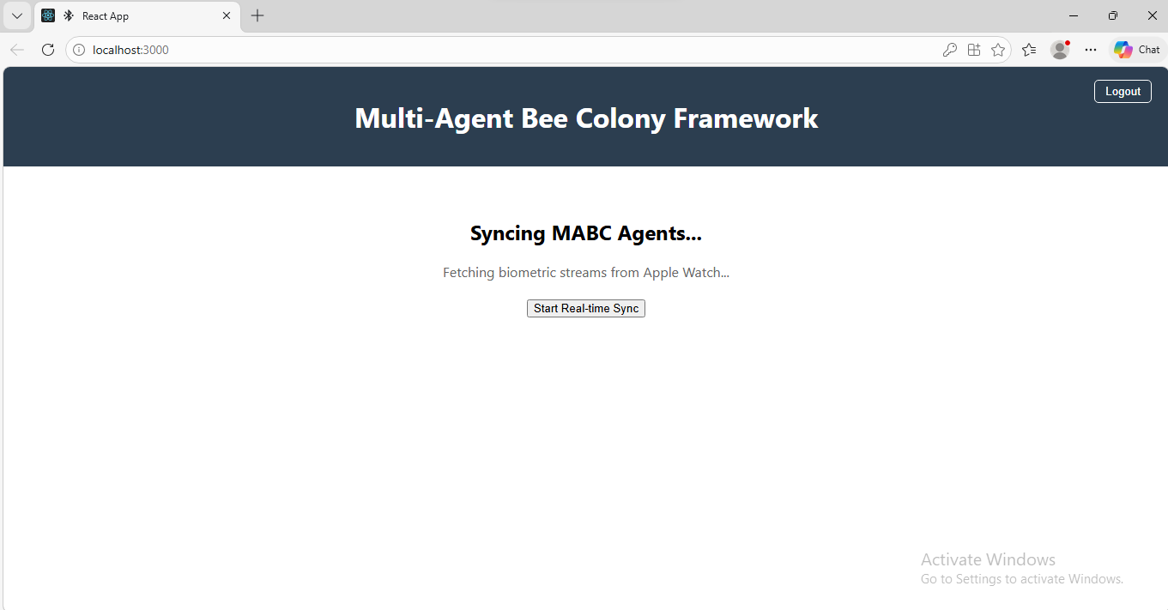
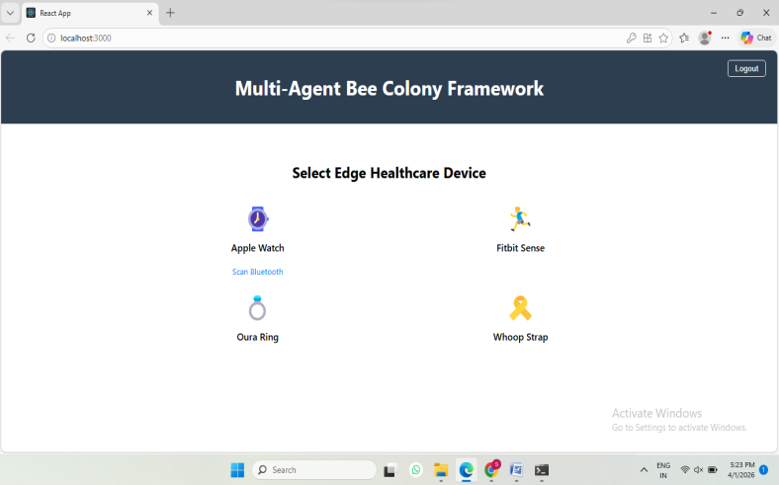
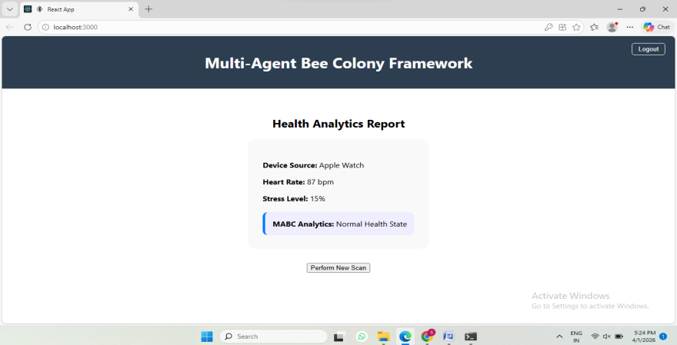
Outputs

Slide 13
Conclusion
The proposed system successfully uses a multi-agent bee colony model for real-time user behaviour prediction in edge healthcare. It improves prediction accuracy and reduces latency compared to traditional systems. The use of edge computing ensures faster processing and better data privacy. The system can adapt to dynamic user behaviour effectively. Overall, it provides a reliable and efficient solution for healthcare monitoring. It is suitable for real-time and practical healthcare applications.

Slide 14
FutureScope
The future scope of this project focuses on making the system smarter and more professional. It will involve adding Advanced AI to predict illnesses before they happen and expanding to support Medical-Grade devices like glucose monitors. We also plan to use Community Swarming, where different users' apps can alert each other about local health trends (like a flu outbreak) without sharing private names. Finally, the system will use Blockchain to create secure, unchangeable health records that can be safely shared with doctors.

Slide 15
References
The project is supported by the foundational work of Karaboga & Basturk (2007) on Artificial Bee Colony optimization and M. Wooldridge (2009) on Multi-Agent Systems. Technical implementation aligns with IEEE 11073 standards for health device communication and M.A. Ferrag’s (2018) research on wearable data privacy. Industry-specific data is derived from official Apple HealthKit and Fitbit API documentation to ensure cross-platform compatibility. Finally, the framework follows World Health Organization (2020) guidelines to maintain ethical and professional digital health standards.

Slide 16
Thank You

